Slide 1
MTA Daily Ridership
Turning Data into Insights

Slide 2






Our Team
SARAH EMAD
team leader
GALAL ELDEEN MOHAMED
TASNEEM MOHSEN
ALYAA IBRAHIM
FATMA HASSAN
MOMEN HAITHEM

Slide 3
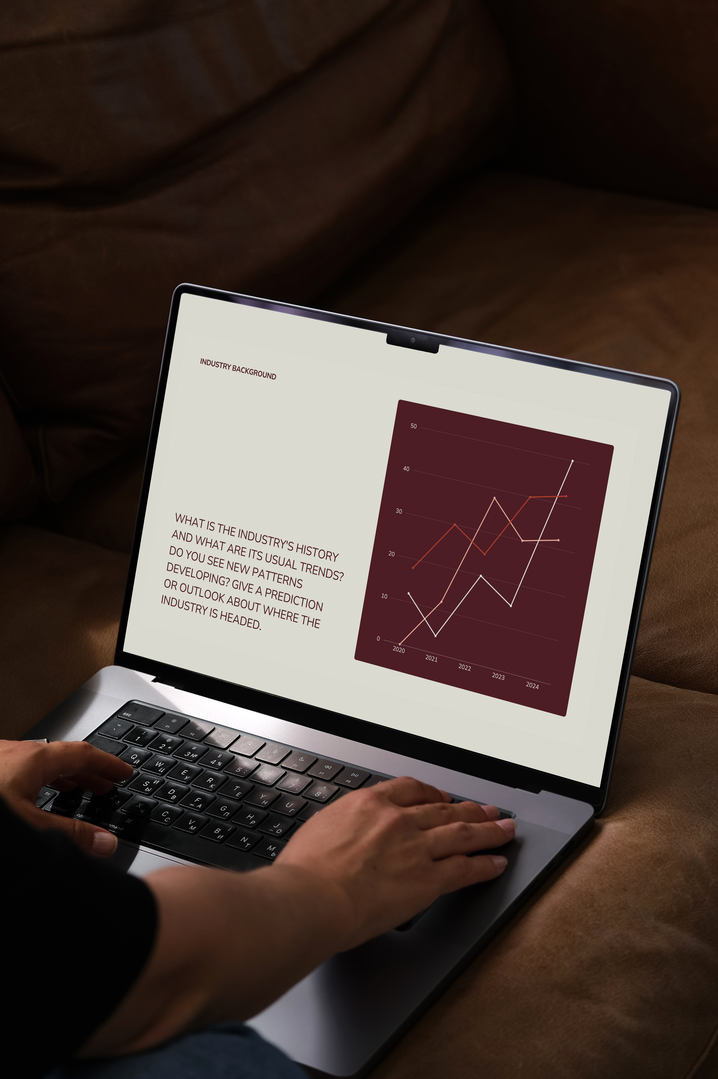
Project Overview
This project focuses on analyzing and forecasting daily ridership trends for the New York Metropolitan Transportation Authority (MTA) across different transit services—such as subways, buses, commuter rails (LIRR and Metro-North), and paratransit (Access-A-Ride). Using post-pandemic data starting in March 2020, the project evaluates how rider behavior has changed, identifies which services are recovering fastest, and provides cost-conscious recommendations to improve service planning and resource allocation.
By leveraging visual analytics and time series forecasting (e.g., ARIMA), the project helps MTA stakeholders make informed decisions about transit operations, budget prioritization, and future investments.

Slide 4
Our Goals
Tracking ridership drops and recoveries across different transit services
Understanding behavioral trends by day of week and season
Forecasting future ridership using time series models
Providing actionable recommendations to optimize costs and operations

Slide 5
DATA CLEANING & PREPARATION
1
EXPLORATORY DATA ANALYSIS
2
Key Areas of Analysis
RECOVERY ANALYSIS
3
FORECASTING (VIA ARIMA)
4

Slide 6
Insights from our Analysis
POST-COVID RECOVERY
1
Some transportation modes (e.g., subway or bus) likely recovered faster than others like LIRR or Metro-North.
Normalized plots probably show Subway rebounding sooner due to higher dependence in urban areas.
WEEKEND VS WEEKDAY TRENDS
2
Ridership patterns may differ significantly between weekdays and weekends.
Recommendations might include adjusting service frequency or staffing based on observed usage.
Weekend ridership is lower across all modes.
Transit demand is highest on weekdays, suggesting potential for off-peak scheduling savings.
SEASONAL OR TEMPORAL TRENDS
3
Monthly or yearly breakdowns could reveal seasonal drops (e.g., holidays) or long-term recovery trends

Slide 7
Insights from our Analysis
TOTAL RIDERSHIP TRENDS
4
Identification of overall rising or falling ridership trends post-2020.
Important for capacity planning and infrastructure investments.
FORECASTING
5
If ARIMA was applied to total_ridership, the model may project future demand, helping in planning service levels.
MODE RECOVERY TRENDS
6
From normalized ridership trends:
Subways and buses likely showed faster recovery post-COVID.
Commuter rails (LIRR, Metro-North) lagged—likely due to ongoing hybrid/remote work reducing daily suburban commutes.

Slide 8
Recommendations
RESOURCE ALLOCATION
1
Increase service where recovery is strongest (e.g., subways on weekdays), reduce frequency for underused services.
TARGETED MARKETING
2
Promote LIRR or Metro-North through pricing or service incentives to stimulate slower-recovering ridership.
POLICY INTERVENTIONS
3
Consider flexible schedules or hybrid work policies to distribute peak demand more evenly.
FORECAST-DRIVEN PLANNING
4
Use ARIMA model forecasts for staffing, maintenance, and budgeting over the coming quarters.

Slide 9
Recommendation | Strategy | Rationale | Impact
1. Prioritize Subways and Buses | Increase service or promotions in high-volume, low-cost transit modes | More cost-effective per passenger; uses existing infrastructure efficiently | High ROI, Short-term gains
2. Reduce Low-Demand Commuter Rail Services | Scale back underused LIRR/Metro-North services, especially on weekends | High operational costs and low ridership; potential for significant cost savings | Millions saved annually
3. Dynamic Scheduling via Forecasts | Use ARIMA models to align service frequency with projected demand | Prevents over-service, minimizes operational waste, and improves efficiency | Smarter resource allocation
4. Off-Peak Travel Promotions | Promote weekend/midday travel to increase usage without major investment | Utilizes existing capacity; avoids cost of fleet expansion or new staff | Low cost, High utilization boost

Slide 10
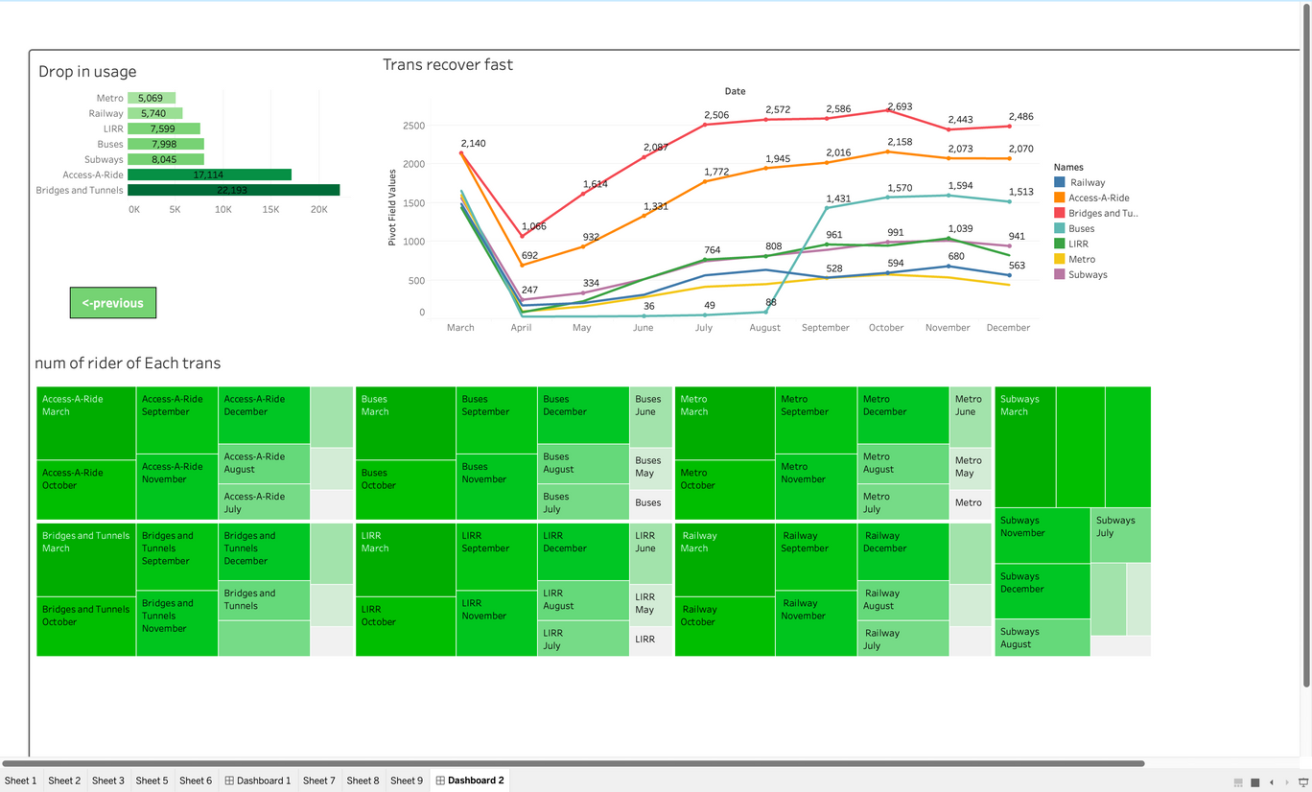
Our Tableau Dashbpard

Slide 11
Thankyou

